Slide 1
Serial Mini Project
Ms. Peterson

Slide 2
3 Questions
Why didn’t the state ever try to contact Don or try to pin him as Hae’s killer? Adnan was her ex-boyfriend, so shouldn’t the current boyfriend also be considered in the case?
What were the contents of Hae’s autopsy report? How long do they think she was in the grave in Leakin Park?
Does Rabia visit Adnan often and what is his life like in prison now?

Slide 3
Research Findings The “Don” Issue
From Susan Simpson’s blog:
Don was not involved in Hae’s murder. Although there was evidence that, at the time of the original investigation, should have caused the police to take a special interest in Don — e.g., Debbie’s statements to the police about Hae’s plans, and the note found in Hae’s car — it appears now that the evidence did not actually suggest that Hae was on her way to see Don at the time of her disappearance. Back in 1999, however, the police did think that — and their failure to investigate Don as they should have is probably a big part of the reason why all the uncertainty about the wrestling match never got sorted out at the time of trial.

Slide 4
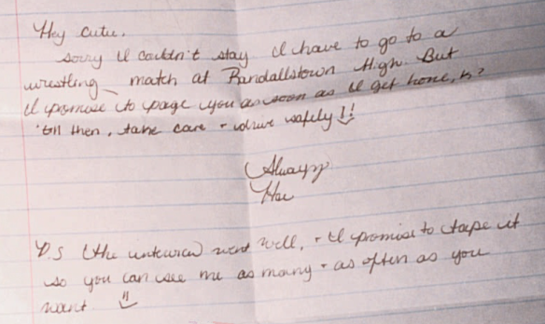
Hae’s Note to Don

