Slide 1
Archetypes and Symbols
It’s not just an apple

Slide 2
Overview
What is the Definition?
What are some examples?
What is the difference between an archetype and a symbol?
What function do archetypes serve in a society or culture?
What universal themes do archetypes reveal?

Slide 3
What is an archetype?
In literature, an archetype is an image, story-pattern, or character type that occurs frequently and evokes strong, often unconscious, associations in the reader.
Archetypes occur across cultures and civilizations.
Carl Jung first applied the term archetype to literature. He recognized that there were universal patterns in all stories and mythologies regardless of culture or historical period and hypothesized that part of the human mind contained a collective unconscious shared by all members of the human species, a sort of universal, primal memory.
Joseph Campbell took Jung’s ideas and applied them to world mythologies and, in particular, the cycle of the hero.

Slide 4
What are the characteristics of archetypes?
They are universal. They are the same across cultures and civilizations.
Their appearance in diverse cultures cannot be explained as many cultures are so separated by geography and time.
Archetypes are recurrent, appearing in slightly altered forms to take present day situations and relate them to the past to find meaning in a contemporary world.

Slide 5
Why are archetypes evident in different cultures and civilizations? What makes them so popular? What function do they serve in a society?

Slide 6
Examples of Archetypes
Characters
Symbols
Themes and Situational

Slide 7
Character Archetypes
What are some of the recurring characters in fairy tales?
The fairy godmother
The wicked stepmother
The mean older sibling
Choose ONE of the characters from the list above and explain why you think it is so popular.

Slide 8
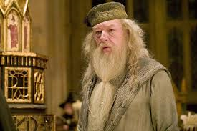
The Mentor
The Mentor—a guide, teacher, or counselor, helps the Hero survive on his or her journey
Examples: Dumbledore

Slide 9
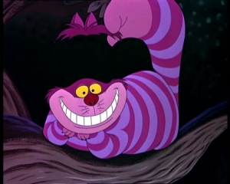
The Trickster
The Trickster—plays tricks or pranks, is usually a good character, often a smaller character that outsmarts one that is bigger or more powerful

Slide 10
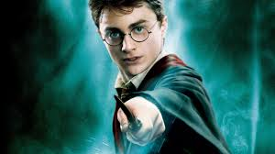
The Hero
The Hero—his or her life follows a specific pattern; he or she is often of supernatural birth; has a specific task to perform--to save his or her society

Slide 11
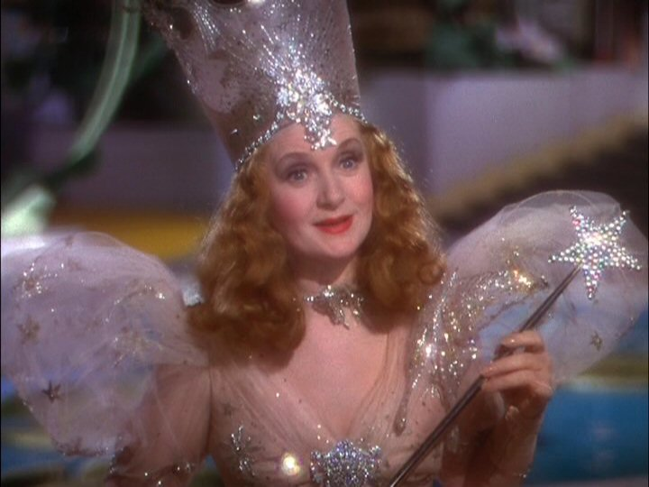
The Benevolent Guide
The Benevolent Guide—a good person that guides a person, usually the Hero, on his or her journey

Slide 12
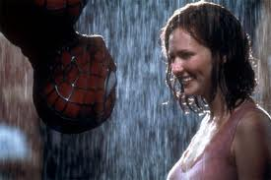
Damsel in Distress
The Damsel in Distress—a woman, usually beautiful, who is in trouble; since the hero most often saves her, she is a trap set by the Villain for the Hero

Slide 13
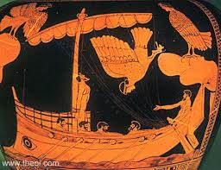
The Temptress
The Temptress—a beautiful woman; a seductress; she tempts the Hero to stray from his journey

Slide 14
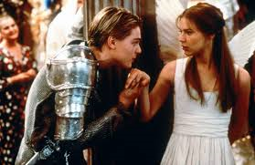
The Star-crossed Lovers
The Star-crossed lovers--a couple whose love cannot survive; it is destined to fail due to family, social norms, etc.

Slide 15
The Scapegoat
The Scapegoat—an innocent person who is blamed for the ills or crimes of his or her society; he or she often must die

Slide 16
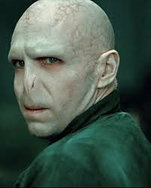
Devil/Villain Figure
The Devil Figure/the Villain—evil person who goes after the Hero

Slide 17
The Outcast
The Outcast—the outsider; he or she is pushed out of his or her society for not fitting the norms

Slide 18
Which contemporary characters from novels, movies, and television shows are archetypes?

Slide 19
Symbol Archetypes
What are some symbols that recur frequently in literature?
Light
Darkness
Water
Fire
Apple
The Four Seasons
A Circle
Crossroads
A maze
A castle or tower
Fog
Colors
Numbers

Slide 20
Symbols
Light—hope, renewal, intellect, knowledge
Darkness—evil, the unknown, ignorance, despair
Water—birth or rebirth, life
Fire—knowledge, light, life, rebirth
Apple—temptation, evil, fertility
The Four Seasons:
Spring—hope, innocence, youth

Slide 21
Symbolic Archetypes
The Four Seasons:
Spring—hope, innocence, youth
Winter—despair, death, old age
Autumn—middle age
Summer--?? We’ll have to investigate
Circle—continuity, eternity, sacred
Crossroads—choices
Maze—confusion
Castle or tower—royalty, refuge, protection
Fog—confusion, the unkown

Slide 22
Archetypal Colors
White—purity, innocence, cleanliness, sterility
Black—death, evil, mystery, seriousness, somber
Red—passion, emotion, creativity, life, courage, blood
Purple—royalty, sacred, holy
Green—growth, fertility, renewal
Blue—protection, loyalty

Slide 23
Archetypal Numbers
Three-
Seven-
These numbers symbolize completion. Can you think of reasons why?

Slide 24
Thematic and Situational Archetypes
What are some common archetypal themes that show up in every culture of the world?
The quest (the Holy Grail)
The hero journey (Hercules, Spiderman)
The initiation or rite of passage
The fall from a higher status to a lower one—a loss of innocence or beliefs
The battle between good and evil
Death and rebirth

Slide 25
Archetypes vs. Symbols
A symbol is a concrete object that stands for, or represents, something larger than itself. A symbol is often unique to a specific culture, society, or time.
An archetype is a unique or special type of symbol that crosses cultural, social, and chronological barriers. Every archetype is a symbol, but not every symbol is an archetype.
“umbrella” is a symbol
“rain” is an archetype
*Is the American flag a symbol or an archetype?

Slide 26
Why do you think archetypes are so common across cultures? Why are they so popular? Reflection: Choose an archetypal character, symbol, theme, or situation and explain why you think it is popular in so many different cultures.

